Slide 1
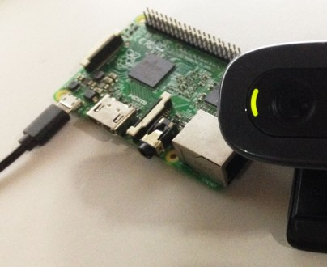

Camera on Wheels
Harshjot Singh | Lovepreet Singh

Slide 2
Introduction
Security is an important aspect of our daily lives
Companies and organizations spend thousands of dollars to ensure security of their premises
Residential customers also spend considerable amounts to buy smart home security systems
Our team has a built a product that can be customized to fit customers needs

Slide 3
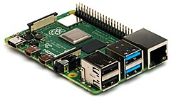
What we have built?
A raspberry pi based remote controlled Surveillance Robot
Can be operated wirelessly
Has a webcam mounted on top for live streaming
Easily accessible
This Photo by Unknown Author is licensed under CC BY-SA

Slide 4
Why We Chose This Project Design?
Can patrol area where humans can’t possibly go
Easy to implement
Cost Effective Security Measure

Slide 5
Major Components
Raspberry Pi 3
Sony PS3 Eye Webcam
A PCB
L293D Motor Driver
Two DC Motors
Steel Box style Chassis
Misc. (Resistors, Capacitors and Diodes)

Slide 6
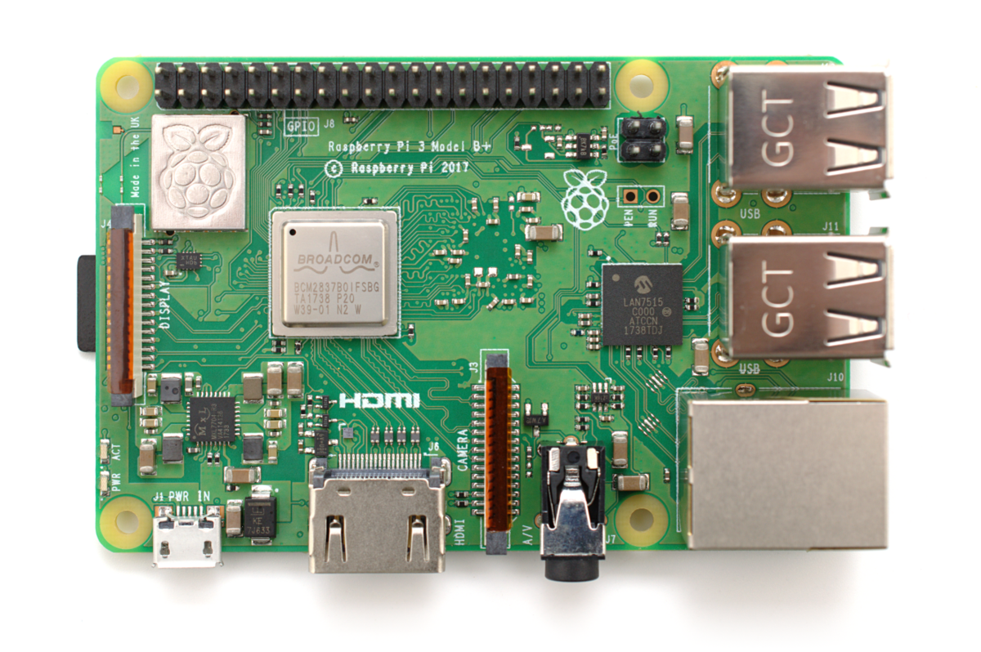
Raspberry Pi 3
It is a compact credit card sized unit that performs all the basic functions efficiently just like a regular PC. It has the following specs –
CPU: 4× ARM Cortex-A53, 1.2GHz GPU: Broadcom VideoCore IV RAM: 1GB LPDDR2 (900 MHz) Networking: 10/100 Ethernet, 2.4GHz 802.11n wireless Bluetooth: Bluetooth 4.1 Classic Storage: microSD GPIO: 40-pin header, populated
This Photo by Unknown Author is licensed under CC BY-SA

Slide 7
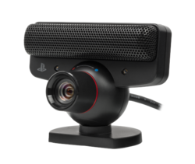
Sony PS3 Eye Webcam
Supports 640x480 pixels @ 60 hz
320x240 pixels @ 120 Hz
Connection Type – USB 2.0 (type-A)
0.3 Megapixel
This Photo by Unknown Author is licensed under CC BY-SA

Slide 8
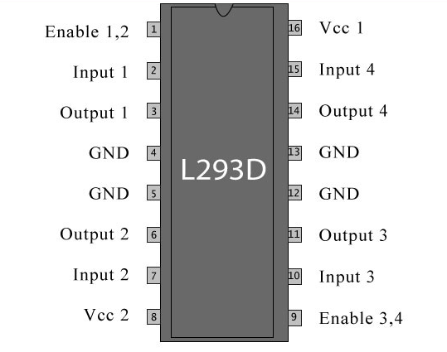
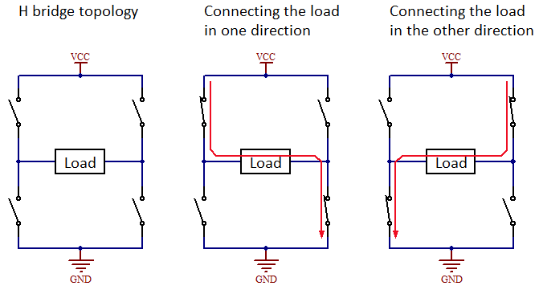
L293D Motor Driver
Used to control direction of motors
Has H-Bridge Configuration
16 Pin IC
8 Pins on each side
This Photo by Unknown Author is licensed under CC BY-SA

Slide 9
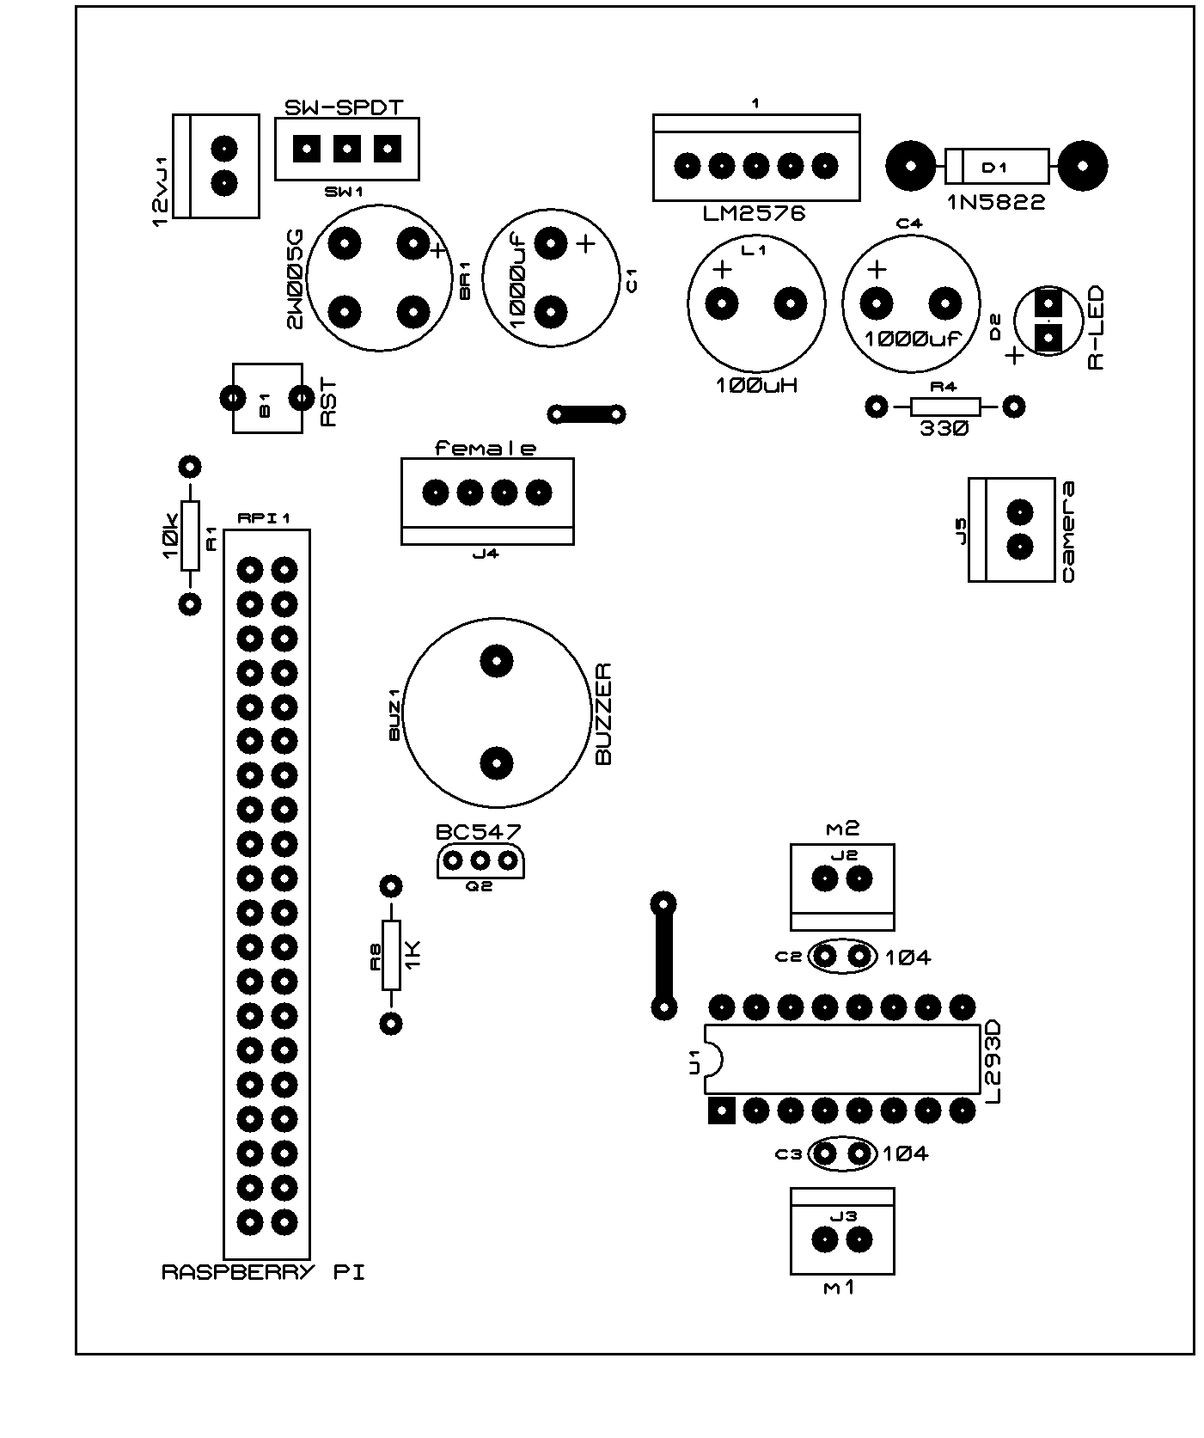
Other Major Components
Other important components of our design are -
2 12VDC Motors
Custom PCB with 1 transistor, 3 Resistors, 2 Capacitors & 2 Diodes.
A Steel Chassis

Slide 10
Functional Features
When we turn on the pi, it connects to the wifi access point
Then it creates a static html page on a local ip address
The html page includes all the controls and live video stream
The page can be accessed by any smartphone or PC that is over the same network

Slide 11
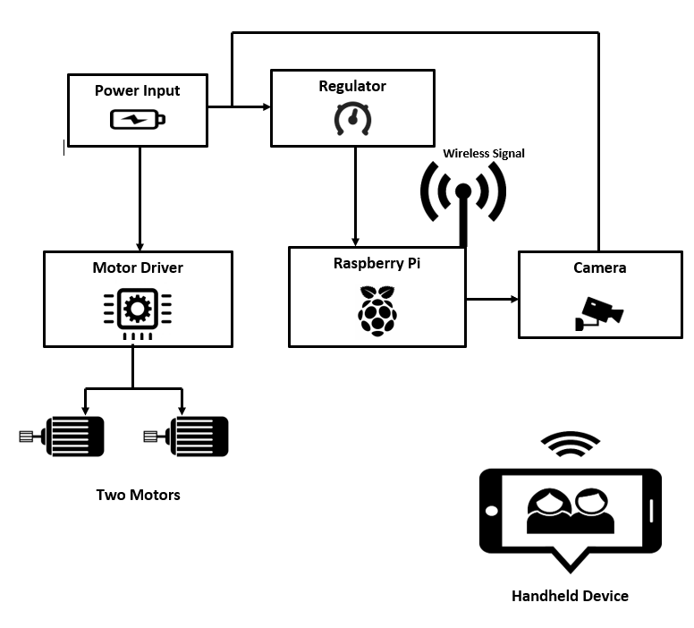
Block Diagram

Slide 12
Step by Step Setup Instructions
Power On
Power On the unit first
Wait
Wait and Let it connect to Wi Fi
Verify
Verify the power input if the red light is turned on at PCB
Scan
Scan for the Pi’s IP Address, it should be 192.168.0.34
Proceed
After you have verified Pi is connected to internet, proceed further.

Slide 13
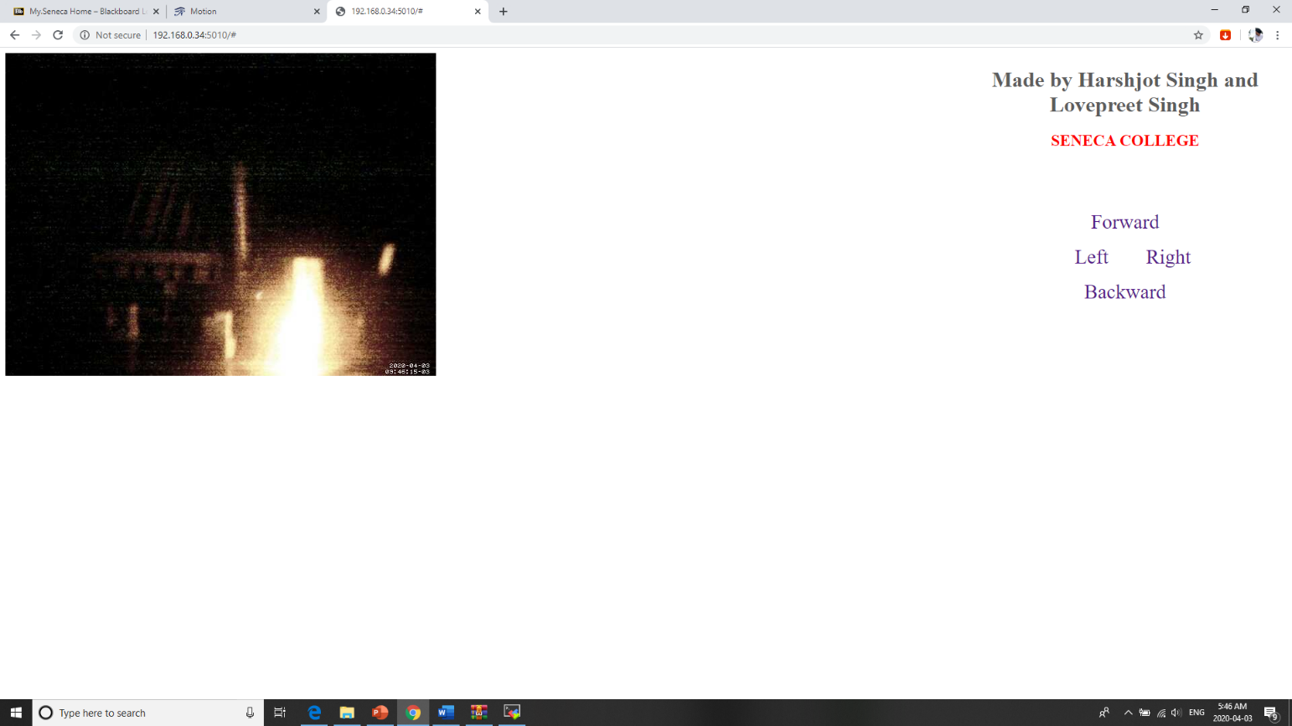
Instructions (Contd.)
Connect your smartphone to the same wifi network
After verification is done, type in 192.168.0.34:5010 on any smartphone or PC connected to same WiFi to access live video stream and controls.
You should land on a similar page as show here

Slide 14
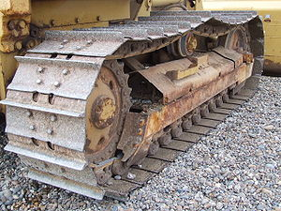
Differential Steering
Our vehicle takes turns using this method
Turns are achieved by altering driving torque on one side
In simpler words, one side of the vehicle is completely shutdown or slowed down to take a turn
Excavators, Tanks and Bulldozers have similar steering method
Front wheels do not turn
This Photo by Unknown Author is licensed under CC BY-SA

Slide 15
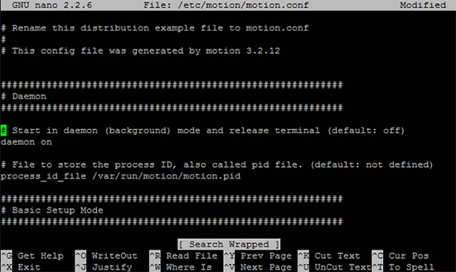
Webcam Server
Achieved by installing Motion
Motion can be installed using sudo apt-get install motion command
Detects motion and turns on the camera
Provides high range of settings and configurations
Allows us to set resolution, frame rate, brightness, contrast etc.
Streams video on the Pi’s IP address
This Photo by Unknown Author is licensed under CC BY-SA

Slide 16
WebApp Development
Coded in Python
Embedded in Pi
Automatically runs the code when Pi boots up
Uses a custom HTML page with controls that integrates livestream from webcam
Can be accessed at 192.68.0.34:5010

Slide 17
Conclusion
The project design has a lot of potential for scalability
It meets the proposed functionality
Given more time and resources this project can be transformed into a more sophisticated surveillance robot that includes sound output as well
Overall our team is satisfied with the outcome

